Slide 1
Amazon Sales
Dashboard Analysis
POWER BI PROJECT
Data Cleaning · Calculated Columns · DAX Measures · 3-Page Interactive Dashboard

Slide 2
AGENDA
What This Deck Covers
1
Objective & Insight
5
DAX Measures
Why this dashboard exists and the business question it answers
Reusable calculations that power every visual
2
Dataset Overview
6
Chart Specifications
6,000-row, 10-column Amazon-style sales dataset
Which chart, which fields, which question it answers
3
Data Cleaning
7
3-Page Dashboard Layout
Power Query steps to fix nulls, duplicates & inconsistent text
Sales Overview · Product Analysis · Regional & Customer View
4
Calculated Columns
8
Key Insights & Recommendations
New fields derived inside the data model
What the numbers actually tell us
Amazon Sales Dashboard | Power BI Project
2

Slide 3
SECTION 1
Objective & Business Question
Objective
!
Headline Insight
Build a 3-page Power BI dashboard on Amazon-style order data that lets a business user move from raw, messy transaction rows to a clean, trusted, interactive view of sales performance — without touching Excel formulas.
62.9M
Key Business Questions
total clean sales across 5,820 valid orders — after removing 180 duplicate rows and 508 incomplete rows from the raw 6,000-row extract.
1
Which categories and products drive the most revenue?
2
How does sales performance trend month over month?
3
Which regions and payment methods should we prioritize?
Furniture is the #1 category by revenue (₹2.15 Cr) despite ranking last in units sold — a high-value, low-volume product line.
4
How much of our raw data is unreliable — and does it change the answer?
Amazon Sales Dashboard | Power BI Project
3

Slide 4
SECTION 2
Dataset Overview
amazon_sales_dashboard_data.csv · 6,000 rows × 10 columns · Jan 2023 – Dec 2024
Column | Data Type | Description
Order_ID | Text | Unique order identifier (e.g. AMZ100243)
Order_Date | Date | Date the order was placed
Category | Text | Product category (10 categories)
Product_Name | Text | Specific product ordered
Quantity | Whole Number | Units purchased in the order
Price | Decimal | Unit price in ₹
Sales | Decimal | Quantity × Price (raw, pre-cleaning)
Region | Text | North / South / East / West / Central
Customer_Name | Text | Customer full name
Payment_Method | Text | Credit Card, UPI, COD, etc.
Raw Data Snapshot
6,000
total rows
180
exact duplicate rows
508
rows with missing values
5,820
clean, unique orders
Amazon Sales Dashboard | Power BI Project
4

Slide 5
SECTION 3
Data Cleaning in Power Query
Query steps applied, in order, inside Power Query Editor before loading to the data model:
01
Promote Headers & Set Types
05
Handle Missing Values
First row → headers; set Order_Date to Date, Quantity/Price/Sales to Decimal Number.
Filtered/flagged blanks in Region, Payment_Method, Customer_Name, Price & Quantity (508 rows) rather than silently guessing.
02
Trim & Clean Text
06
Filter Invalid Rows
Applied to Region — removes leading/trailing spaces (" North", "South ") picked up at source.
Removed rows where Quantity ≤ 0 — data-entry errors that would distort revenue totals.
03
Standardize Case
07
Recompute Sales
Format > Capitalize Each Word on Region so "north", "NORTH", "North" all merge into one value.
Replaced the raw Sales column with a calculated column so every row is internally consistent.
04
Remove Duplicate Rows
08
Close & Load to Model
Remove Rows > Remove Duplicates across all columns — removed 180 exact duplicate order rows.
Loaded the cleaned table into the Power BI data model for measures and visuals.
Amazon Sales Dashboard | Power BI Project
5

Slide 6
SECTION 4
Calculated Columns
Added inside the Power BI data model (Table view > New Column) — computed row-by-row and stored in the table.
Column | Formula | Purpose
Order Month | Order Month = FORMAT(Amazon_sales[Order_Date], "MMM YYYY") | Text label for slicers and axis grouping without altering the underlying date.
Order Year | Order Year = YEAR(Amazon_sales[Order_Date]) | Enables year-over-year filters and visuals.
Price Tier | Price Tier = IF(Amazon_sales[Price] >= 3000, "Premium", IF(Amazon_sales[Price] >= 1000, "Mid", "Budget")) | Buckets products into pricing segments for the Product Analysis page.
Is Weekend Order | Is Weekend = IF(WEEKDAY(Amazon_sales[Order_Date],2) > 5, "Weekend", "Weekday") | Flags weekend vs weekday orders for demand-pattern analysis.
Amazon Sales Dashboard | Power BI Project
6

Slide 7
SECTION 5
DAX Measures
Added in Report view (Modeling > New Measure) — calculated on the fly in the current filter context, used by every chart & KPI card.
fx
Total Sales
fx
Total Customers
SUM(Amazon_sales[Sales])
DISTINCTCOUNT(Amazon_sales[Customer_Name])
fx
Total Orders
fx
Sales MoM % Change
DISTINCTCOUNT(Amazon_sales[Order_ID])
DIVIDE([Total Sales] - CALCULATE([Total Sales], DATEADD(Amazon_sales[Order_Date], -1, MONTH)), CALCULATE([Total Sales], DATEADD(Amazon_sales[Order_Date], -1, MONTH)))
fx
Units Sold
fx
Top Category Sales
SUM(Amazon_sales[Quantity])
CALCULATE([Total Sales], TOPN(1, VALUES(Amazon_Data[Category]), [Total Sales]))
fx
Avg Order Value
fx
% of Total Sales
DIVIDE([Total Sales], [Total Orders])
DIVIDE([Total Sales], CALCULATE([Total Sales], ALL(Amazon_Data)))
Amazon Sales Dashboard | Power BI Project
7

Slide 8
SECTION 6
Chart Specifications
Each visual is scoped to one clear question — mapped to the dashboard page it appears on.
Page | Chart Type | Fields Used | Question It Answers
Page 1 | Line Chart | Order Month (axis) × Total Sales (value) | Is revenue trending up or down over time?
Page 1 | Donut Chart | Payment_Method (legend) × Total Sales | Which payment method contributes most revenue?
Page 1 | Bar Chart | Region (axis) × Total Sales | Which region sells the most, at a glance?
Page 2 | Clustere Bar | Category (axis) × Total Sales | Which categories drive revenue?
Page 2 | Column Chart | Product_Name (Top 5) × Total Sales | What are our five best-selling products?
Page 2 | Clustered Column | Category × Units sold | Where does volume differ from revenue?
Page 3 | Bar Chart | Region × Total Orders | Which region places the most orders (not just ₹)?
Page 3 | Donut Chart | Region × Total Sales share | What % share does each region hold?
Page 3 | Column Chart | Payment_Method × Total Orders | Which payment method is used most often?
Amazon Sales Dashboard | Power BI Project
8

Slide 9
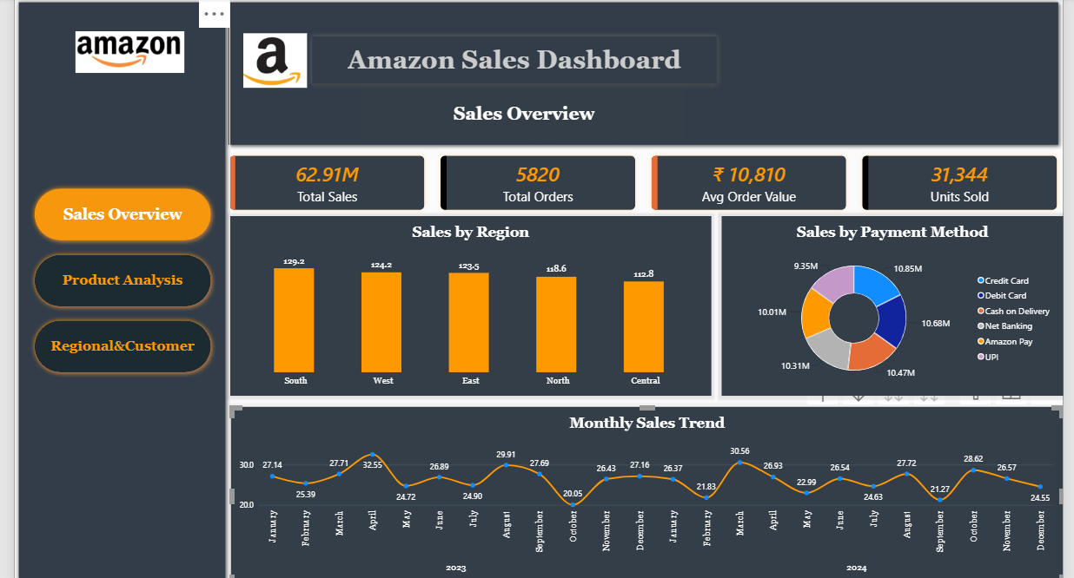

Slide 10
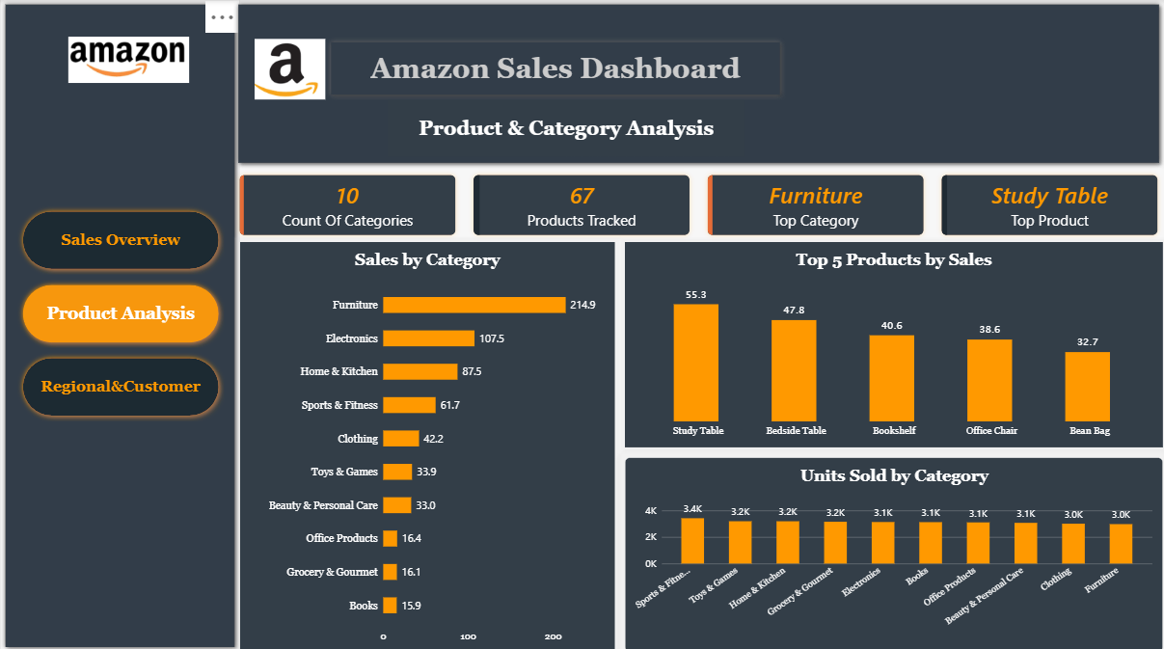

Slide 11
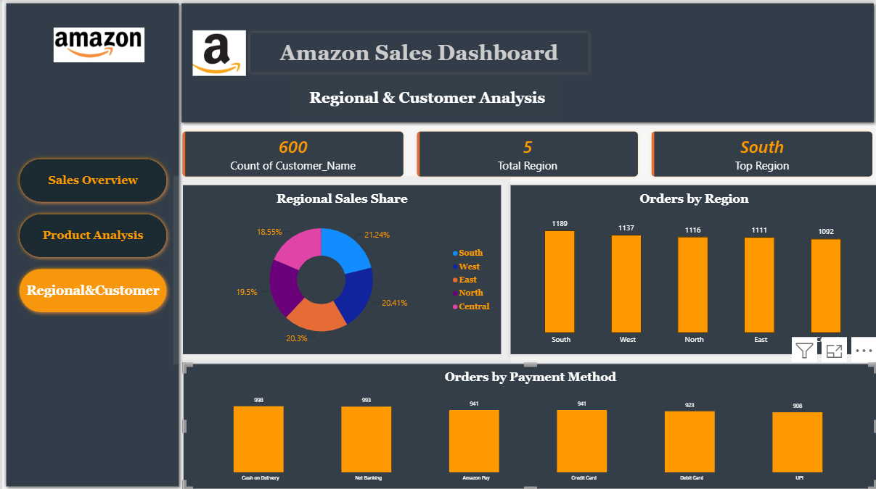

Slide 12
SECTION 8
Key Insights
1
Furniture leads on revenue, not volume
2
No single region dominates
Furniture earns ₹2.15 Cr (34% of total sales) from just 2,973 units — the lowest unit count of any category. High average selling price, not order count, drives this category.
Sales are evenly spread: South leads at ₹1.29 Cr but trails Central (last place) by only 13%. Regional strategy should focus on category mix, not broad regional pushes.
3
Card payments still lead, but the gap is narrowing
4
8% of raw data was unusable before cleaning
Credit Card (₹1.08 Cr) and Debit Card (₹1.07 Cr) top the list, but UPI — the newest method — already accounts for ₹93.5 L, showing fast digital-payment adoption.
180 duplicate rows + 508 rows with missing Region, Payment Method, Customer, Price or Quantity had to be resolved in Power Query — without this step, revenue totals would have been overstated.
Amazon Sales Dashboard | Power BI Project
12

Slide 13
CONCLUSION
From Raw Rows to a Trusted Dashboard
A disciplined Power Query cleanup — deduping, trimming, standardizing case and filtering invalid rows — turned a noisy 6,000-row export into 5,820 trustworthy orders. Calculated columns and DAX measures then made every KPI and chart consistent across all three dashboard pages.
Deliverables
6,000-row source CSV
Cleaned Power Query model
Recommendations
4 calculated columns
✓
Double down on Furniture & Electronics — highest revenue per unit sold
8+ DAX measures
✓
Investigate the October dip (both years) for seasonality or stock issues
9 charts across 3 pages
✓
Promote UPI/Amazon Pay to shift customers off higher-friction COD orders
Automate the Power Query cleaning steps so every data refresh stays trustworthy
This summary deck
✓

